Slide 1
Neurodata MRI to Graphs (NDMG)
A low resource multimodal pipeline to democratize connectome estimation and analysis
Derek Pisner, Alex Loftus, and Ross Lawrence
08/19/2019
Notes:
OUR CENTRAL DEVELOPMENT GOAL HAS BEEN TO CREATE A PIPELINE THAT ANYBODY CAN RUN. Don’t need a supercomputer, don’t need a gpu or a cluster. Can run it on your laptop. In fact, we can even run it over the4 course of the presentatioin.

Slide 2
A brief overview of diffusion MRI (dMRI)

Slide 3
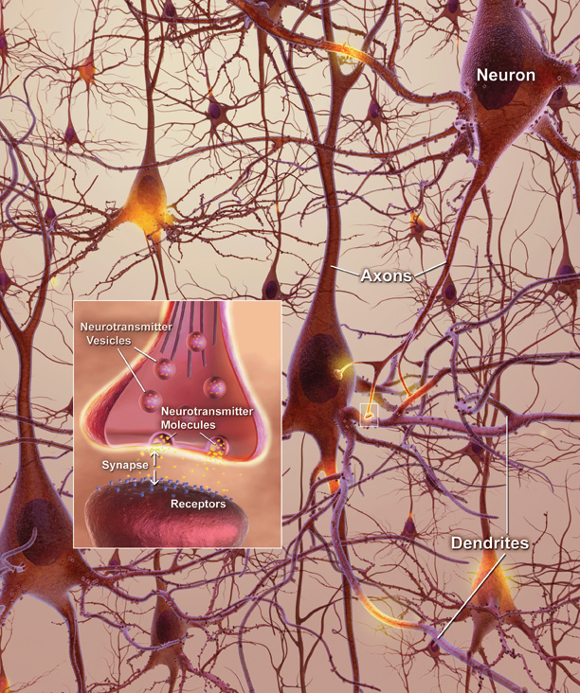


White-matter imaging as a study of microstructural connectivity
Axons measure ~μm in width
Group together in bundles that traverse the white matter
Can’t image individual axons but we can image bundles (i.e. and more broadly fascicles) with dMRI
Useful for studying neurodegenerative diseases, stroke, aging, development…
$$?$$
$$≈$$
Notes:
white matter is composed of both myelinated and unmyelinated axons, blood vessels, and all major types of glia.

Slide 4
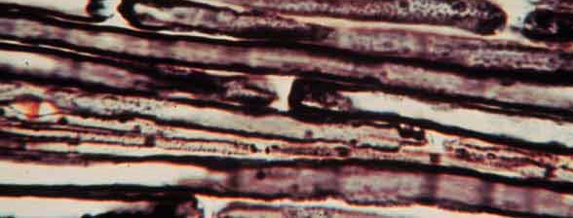
Diffusion in brain tissue
Differentiate tissues based on the diffusion (random motion) of water molecules within them
Gray matter: Diffusion is uniformly restricted
⇒ isotropic
White matter: Diffusion is preferentially restricted
⇒ anisotropic
Notes:
The architecture of the axons in parallel bundles and their myelin shield facilitate the diffusion of the water molecules along their main direction. myelin sheath surrounding an axon restricts the diffusion of water perpendicular to the axon, while allowing relatively free diffusion of water parallel to the axon.
Water molecules, in our body, undergo random translational motion. In physics, this motion is called "Brownian Motion", or simply "Diffusion". If we apply special diffusion-encoding gradients, the magnetic resonance (MR) images can be made sensitive to this motion.

Slide 5
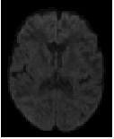
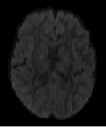
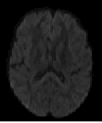
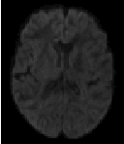
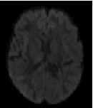
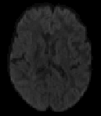
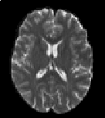
Diffusion MRI
Diffusion encoding in direction d₁
Magnetic resonance imaging can provide “diffusion encoding”
Magnetic field strength is varied by gradients in different directions
Image intensity is attenuated depending on water diffusion in each direction
Compare with reference image(s) to infer diffusion relative to non-diffusion signal
d₂
d₃
d₄
d₅
d₆
No diffusion encoding
Notes:
The sample (a brain) is placed in a strong magnetic field
Protons are magnetized and align with the field
The protons are excited through application of RF pulses
Magnetic field gradients are applied across the sample to select and to modulate the magnetization
Coils are used to detect the change in magnetization of the sample (in a spatially selective manner).

Slide 6
Diffusion MRI = Gradient Magnitudes + Directions

Slide 7

Gradient directions
B-vectors are the x, y, z coordinates whose polarity is set by the scanner gradients and are described with respect to the person in the scanner
Notes:
# of rows = # directions

Slide 8
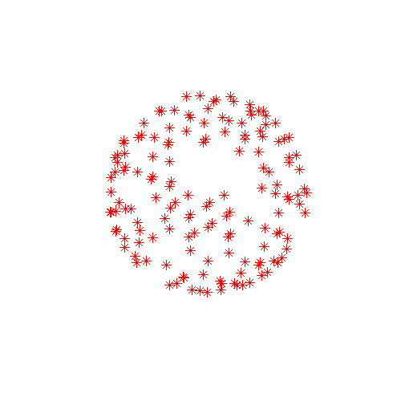
Number of gradient directions matters
In principle, ↑ directions = ↑ reliable estimation of diffusion.
Caveat: increased imaging time = ↑ cumulative noise (Jones, 2004)
DTI:
>6, but usually 10’s of directions
DSI:
Usually few 100’s of directions
Notes:
Subject discomfort, more susceptible to artifacts due to motion, respiration, etc.

Slide 9
Gradient magnitude
B-values depend on acquisition parameters:
b = γ² G² δ² (Δ - δ/3)
γ gyromagnetic ratio
G strength of diffusion-encoding gradient
δ duration of diffusion-encoding pulse
Δ interval of diffusion-encoding pulses
90
δ
180
acquisition
G
Δ
Notes:
The extend to which the image is weighted by diffusion is controlled by the b-value.
Lower Gamma
Upper Gamma
Lower Delta
Upper Delta
Lower Delta

Slide 10
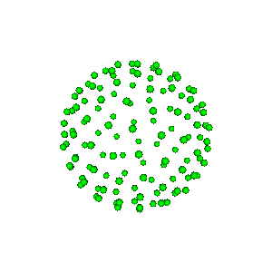
Strength of gradients matters
Increasing b-value leads to:
Increased tissue contrast with areas of higher / lower diffusivity
More noise relative to signal (↓ SNR) ⇒ ↓ reliable estimation of diffusion
DTI(uniform b-values): b ~ 1000 sec/mm²
DSI (many directions): b ~ 10,000 sec/mm²
Multi-shell (multiple b-values): b ~ 1,000; 2,500; 5,000 sec/mm²

Slide 11
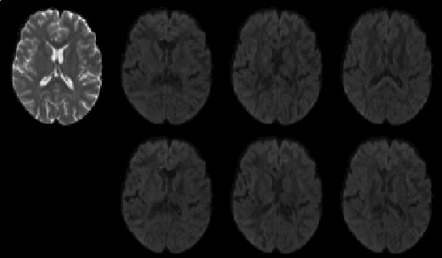
Looking at the data
A diffusion dataset consists of:
Non-diffusion-weighted a.k.a “low-b” reference images (b-value = 0)
Diffusion-weighted images (DWI) with different gradient directions d₁, d₂, and b-value >0.
bvec: B-vectors
bval: B-values
DWI have lower intensity values
b=0
b₁, d₁
b₂, d₂
b₃, d₃
Baseline
(b0) image
Diffusion-weighted
images
b₄, d₄
b₅, d₅
b₆, d₆
Notes:
The simple answer is that T2 weighted imaging makes structures with lots of water appear bright and T1 weighted imaging makes water dark and structures containing fat comparatively bright.
Basic T1 weighted imaging is useful for assessing structures that are high in fat or structures that are near water filled structures, such as joints, that would otherwise be hard to see on T2 weighted imaging.
Basic T2 weighted imaging is useful for assessing water rich structures and also for looking for local inflammation - which results in a higher volume of water in the affected tissues and so they appear bright on this sequence.

Slide 12
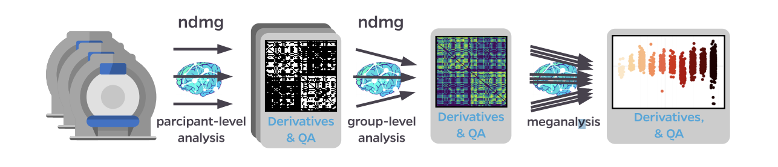
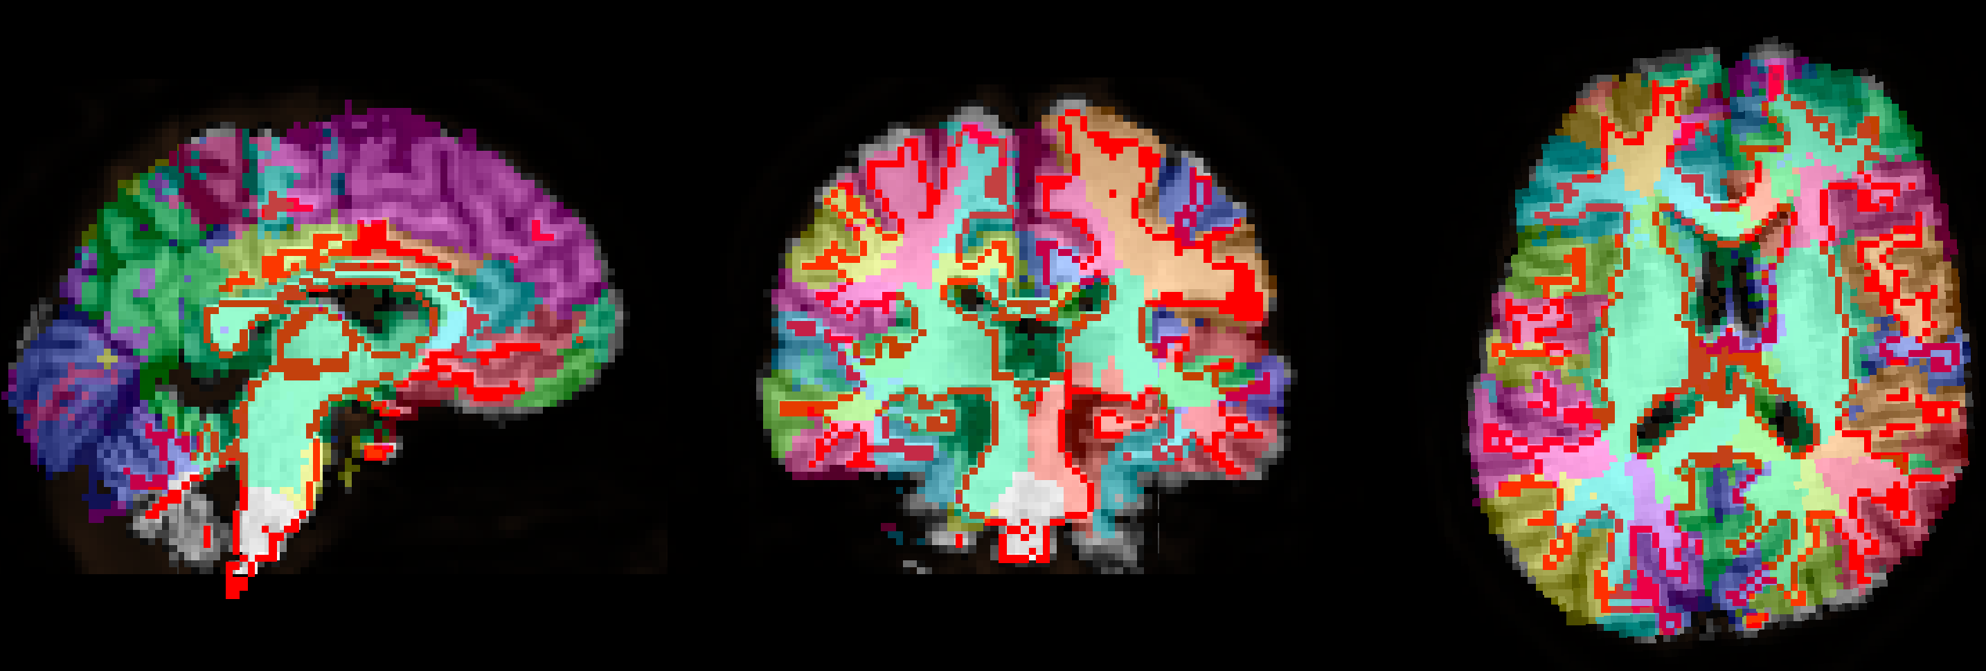
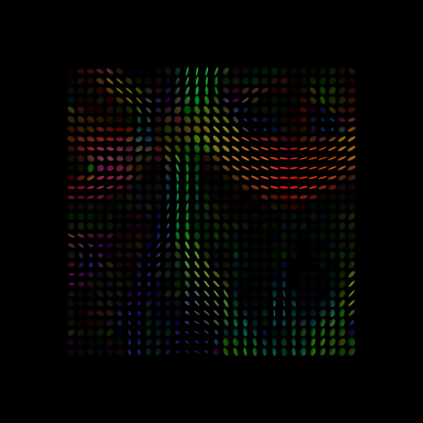
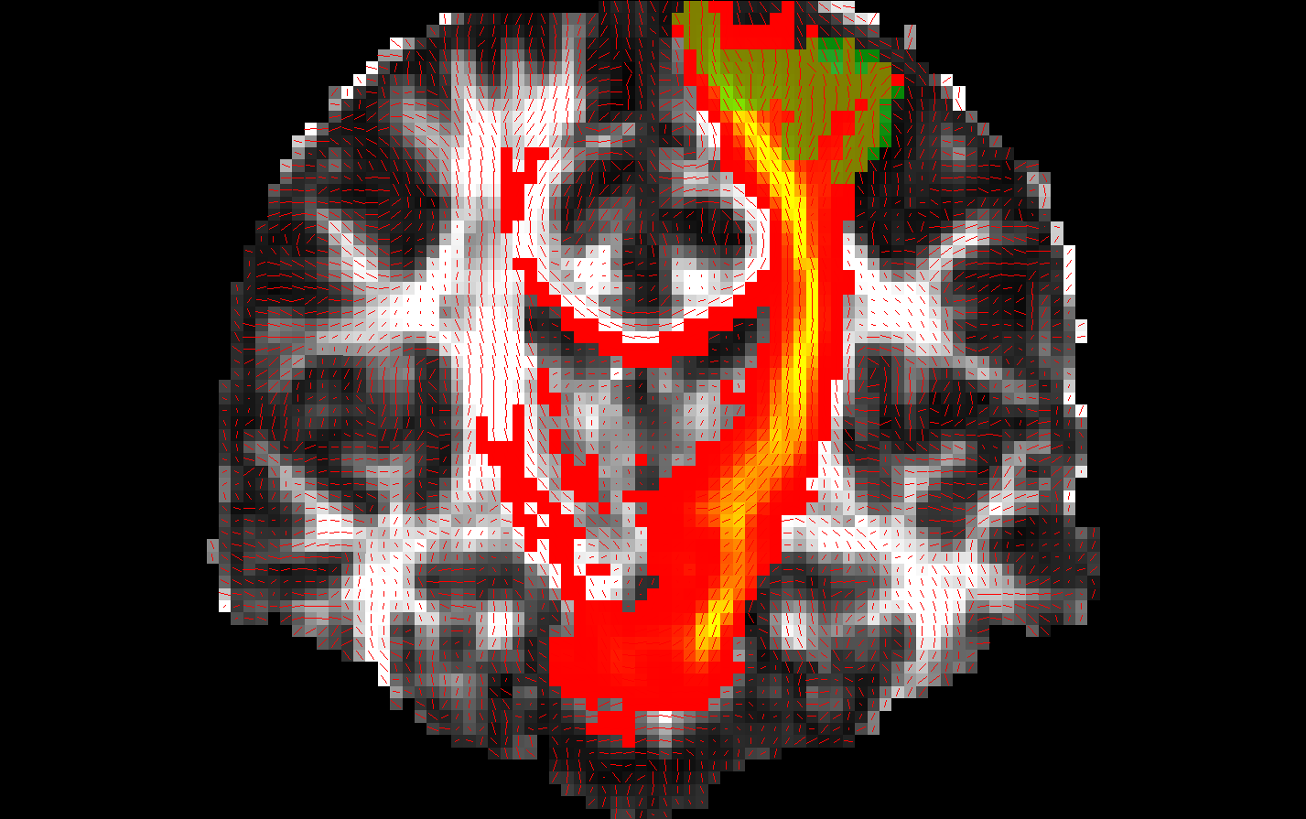
Data analysis steps
Pre-process images to reduce distortions
Registration
Reconstruction
Tractography
Connectome

Slide 13
NDMG
An end-end tool for efficiently generating high quality structural connectomes.
Scalable to large datasets, intended for mega-analysis
Begin with raw NIFTI1 data (BIDS spec), end with graph(s)
Total runtime 20 min – 1 hour
Tractography in different spaces:
native-space, native-space with MNI-normalization, and MNI-space
Different types of tractography:
Deterministic, probabilistic, particle
Use different diffusion models:
CSA, CSD

Slide 14
Preprocessing
Notes:
Susceptibility artifact– some tissue in the brain has a greater tendency to become magnetized when placed in an external magnetic field.

Slide 15
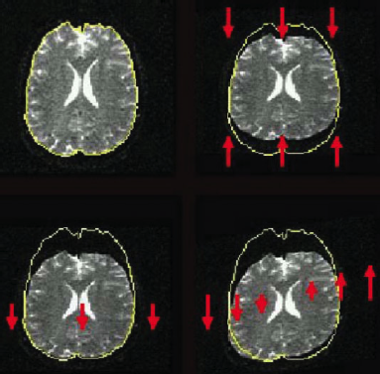
Distortions: Eddy currents
Cause: Fast switching of diffusion-encoding gradients induces eddy currents in conducting components
Eddy currents lead to residual gradients that shift the diffusion gradients
The shifts are direction-dependent, i.e., different for each DW image
Result: Geometric distortions
From Le Bihan et al., Artifacts and pitfalls in diffusion MRI, JMRI 2006
Notes:
Not the only form of preprocessing, but an essential one.

Slide 16
NDMG Preprocessing
Perform eddy correction on the dMRI series.
Reorient all neuroimages to RAS+ and reslice to either 1 mm or 2 mm voxel resolution
Create a mean B0 brain mask of all B0’s found in the dMRI series
Notes:
ALEX’s SLIDE
Requires inversion to x, y, or z columns of bvecs depending on dimension of reorientation.
Reslicing to the same voxel scale enables dramatically faster registration

Slide 17
Registration

Slide 18
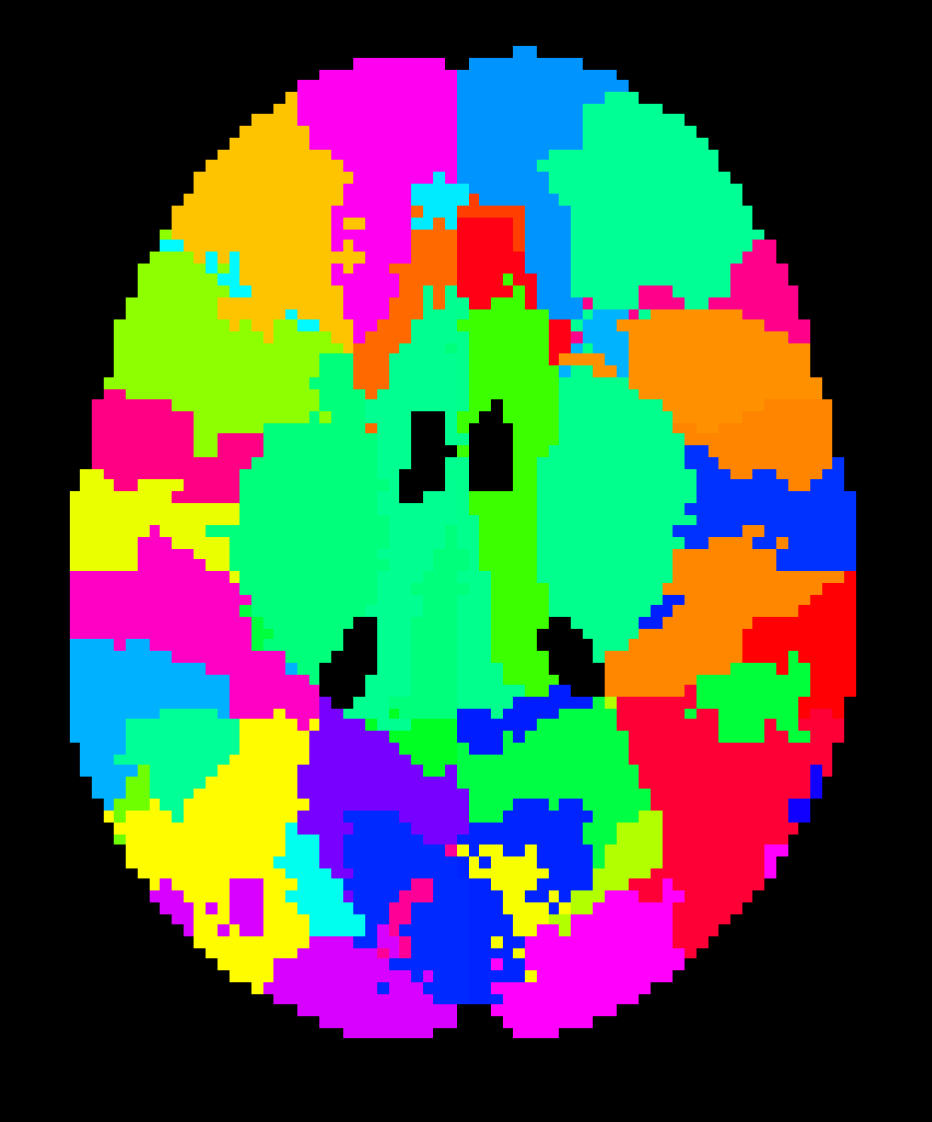
GOAL: Get atlas (what’s that?) to native diffusion space (what’s that?)
Notes:
ALEX’s SLIDE

Slide 19
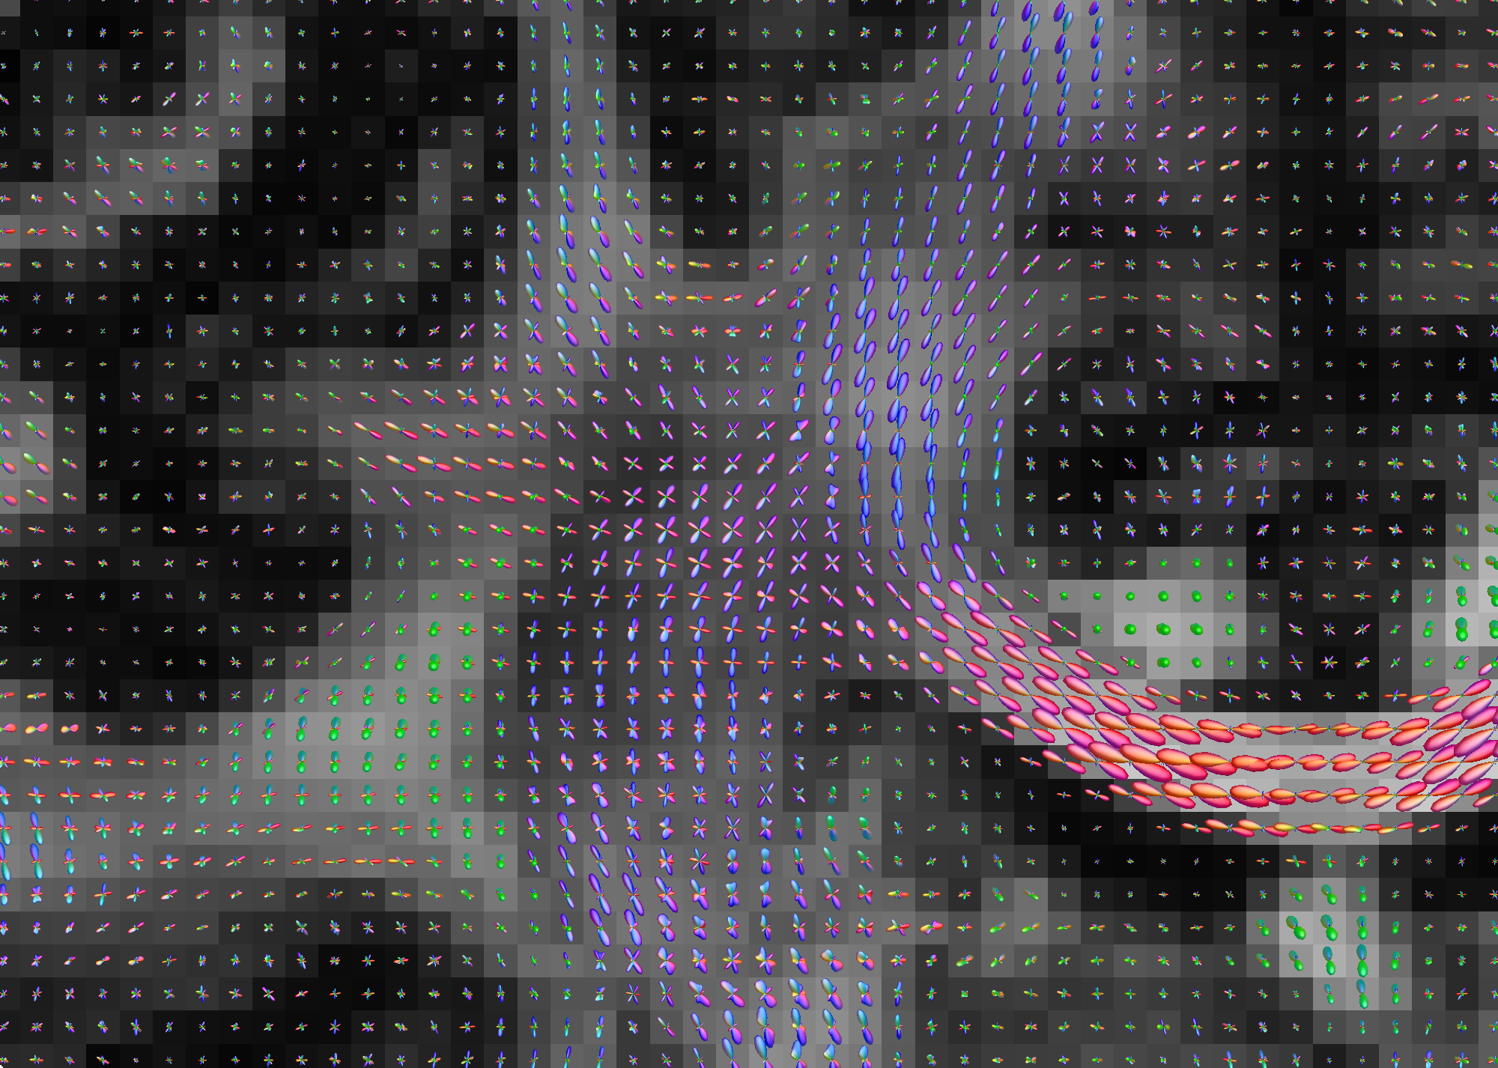
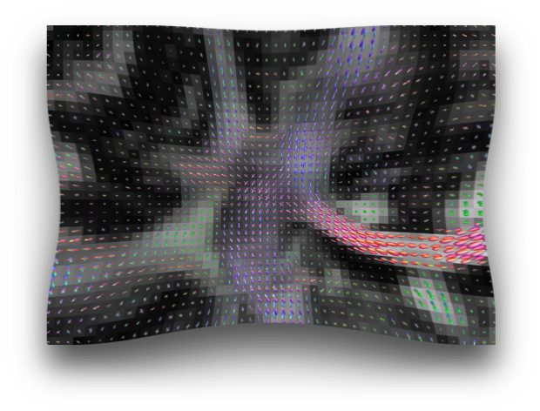
Why not just register a dMRI directly to MNI-space like we do with fMRI?
This requires intermodal registrations, which presents a unique challenge for dMRI.
Notes:
When reorientating fixels, one major undesirable effect is that the maxima in the native fixels no longer corresponds to the maxima in the reoriented fixels (Christiaens et al., 2012).
This is because the reorientation introduces dimple artifacts hypothesized to be from the negative lobes in the Gibbs ringing. This directly affects subsequent deterministic and probabilistic fiber tractography performed in the template space, producing streamlines that do not match the original streamlines from native space. Moreover, streamline distributions generated from probabilistic tractography performed on reoriented fixels are deflected with respect to the native tract distribution (Christiaens et al., 2012).
Although the latest work in FOD reorientation (FODR) using apodized point spread functions (PSFs) overcomes the dimple artifacts, slight distortions are still introduced into the spread of the fiber populations (Raffelt et al., 2012). On average the angular error between peak orientations is ∼8° (Raffelt et al., 2012). The error in peak orientation accumulates into large errors when performing tractography after normalization (Colon-Perez et al., 2015). Moreover, an obvious drawback of these types of solutions is that they depend specifically on the diffusion sampling and reconstruction method used and do not generalize easily to other diffusion methods.
Given the problems that arise from spatially normalizing diffusion information prior to streamline construction, we sought to determine if direct streamline normalization (DSN), where the streamlines are created first, in the same space as the diffusion scans, followed by the warping of these streamlines into the template space would yield more precise results. In this case, the deformation fields from the normalization of each subject to the template are used for warping the streamlines (Hua et al., 2008; Thottakara et al., 2006). DSN confers multiple potential advantages. DWIs can be acquired with any desired sampling scheme. Diffusion tensors, FODs, or ODFs can also be reconstructed using any desired method and streamlines generated using any algorithm. Most importantly, it avoids the problem of generating streamlines from reoriented diffusion tensors, FODs, or ODFs that are distorted relative to their native counterparts, which substantially reduces errors in tract morphology relative to the subject’s native structure.

Slide 20
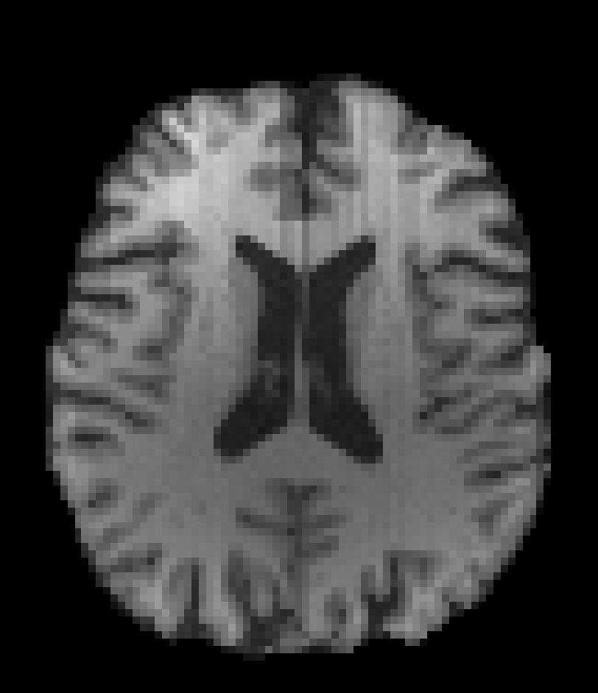
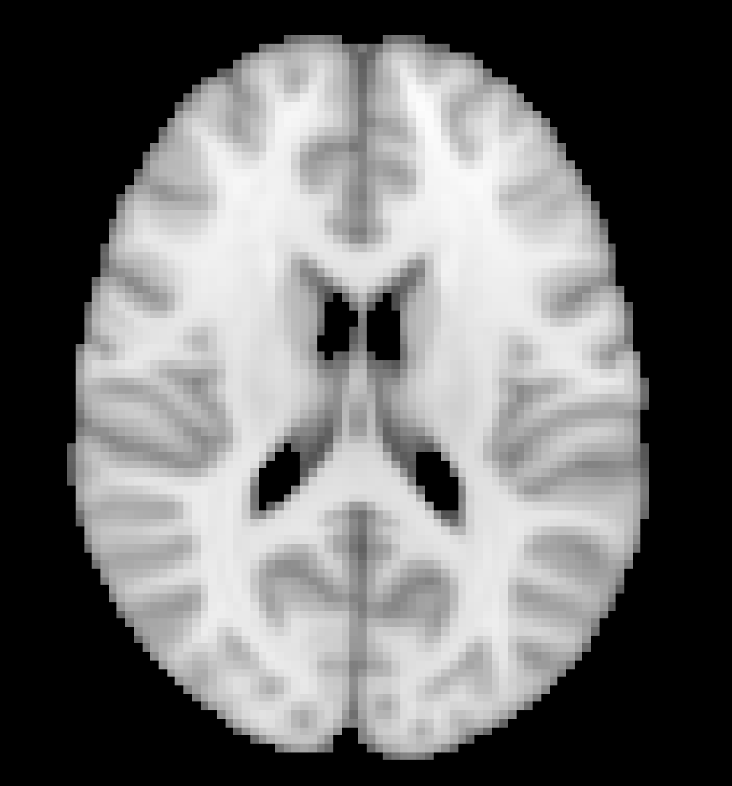
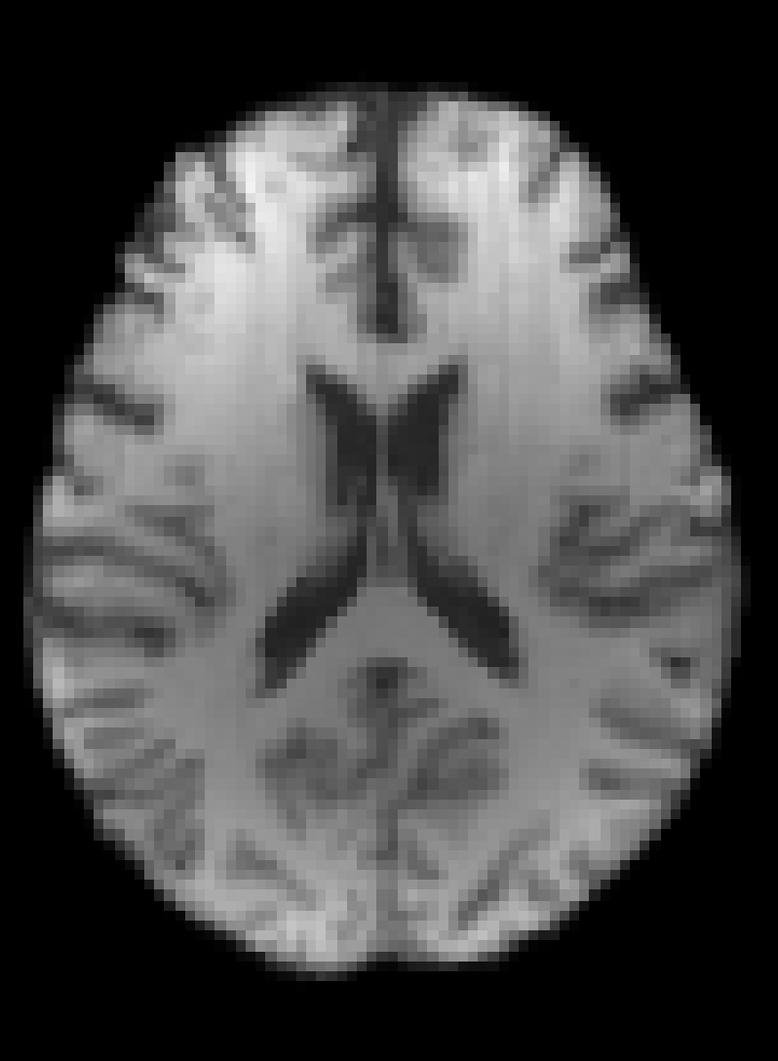
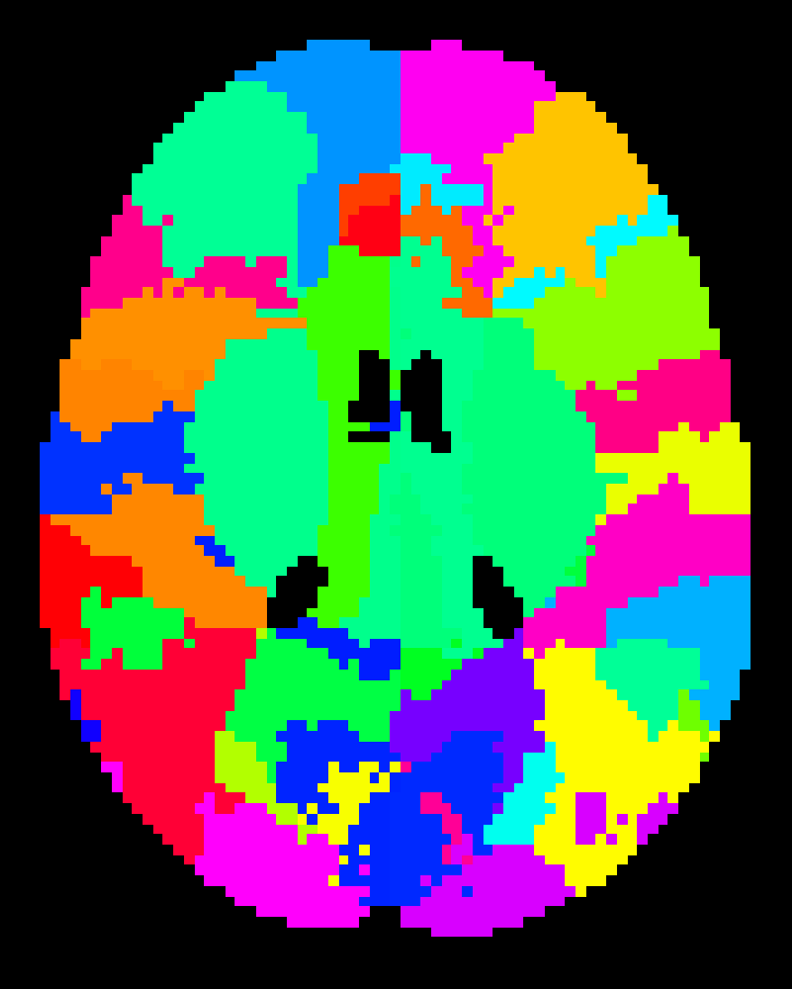
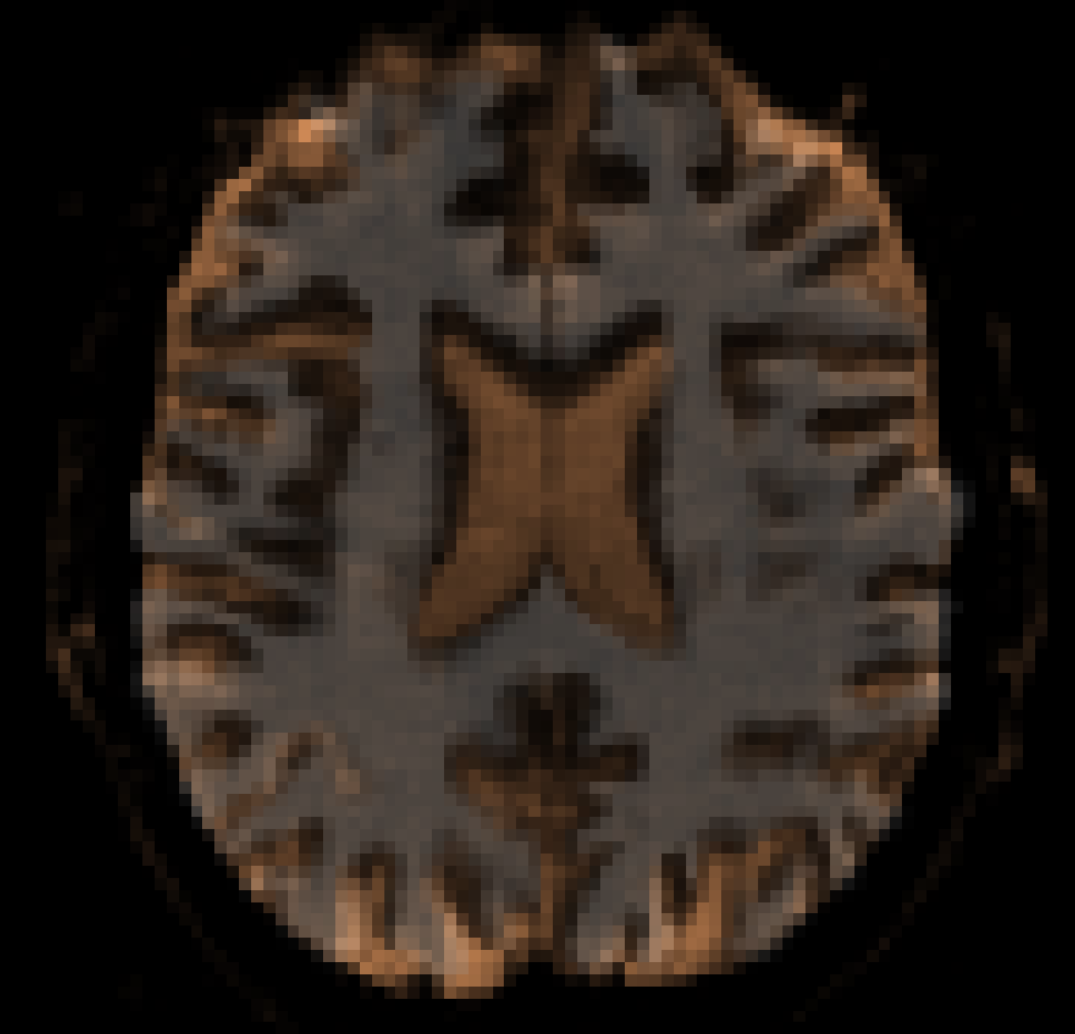
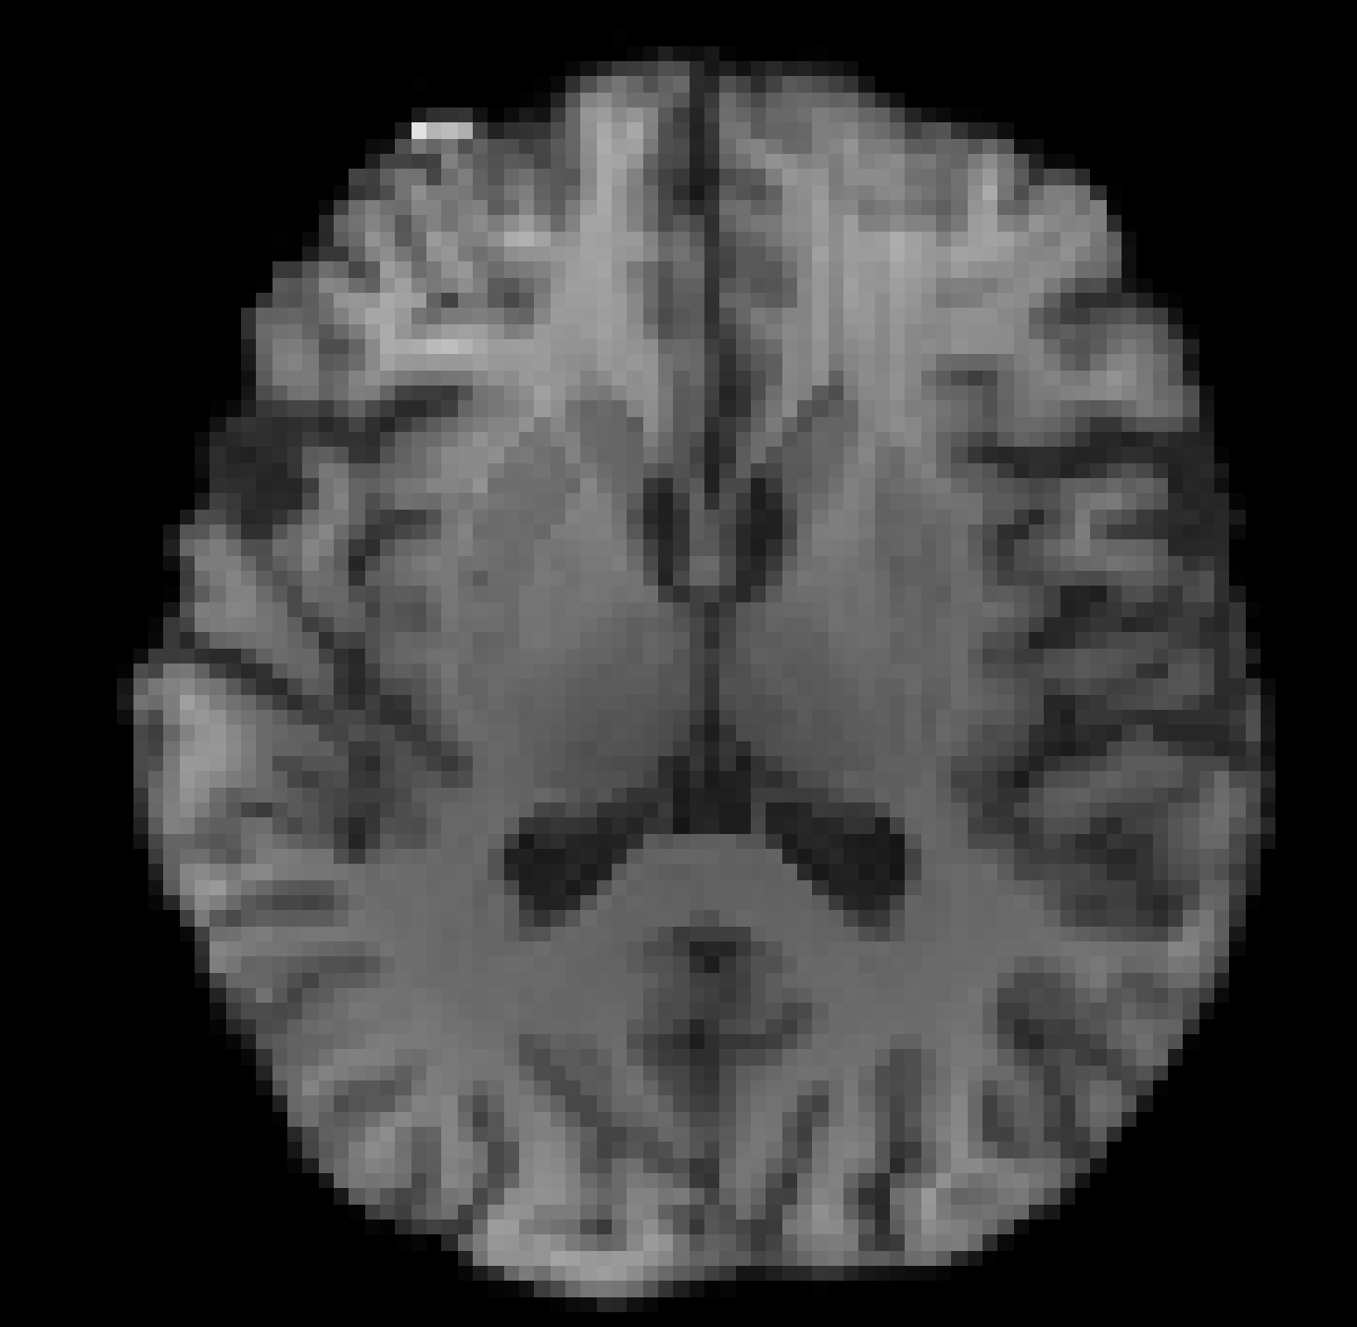
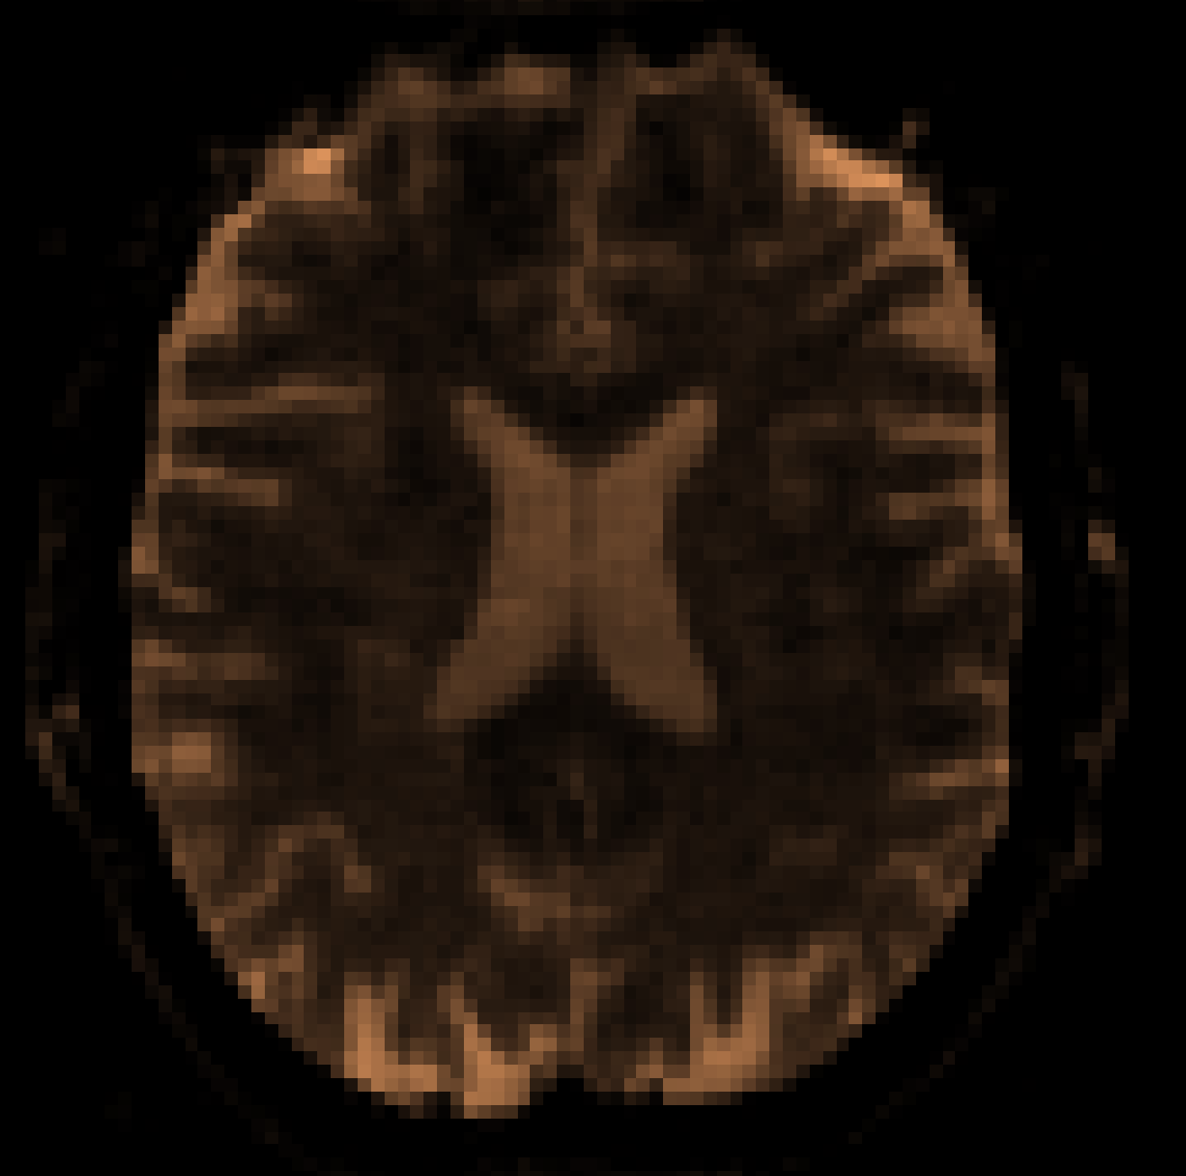
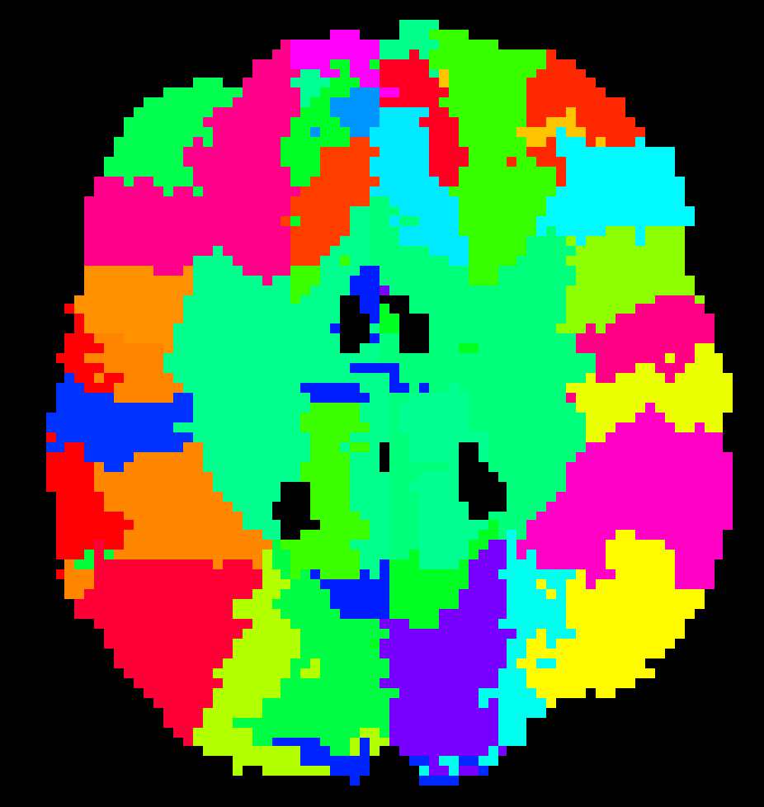
NDMG registration
Learn non-linear T1w → MNI
Learn non-linear warp from Atlas → T1w in MNI space
Learn T1w → native dMRI (linear with ‘boundary-based’ tissue priors from T1w white-matter segmentation)
Apply T1w MNI → T1w (apply inverse of non-linear warp from (1)) → native dMRI (transform from (3))

Slide 21
Estimate diffusion directions at each voxel (i.e. ‘Reconstruction’)

Slide 22
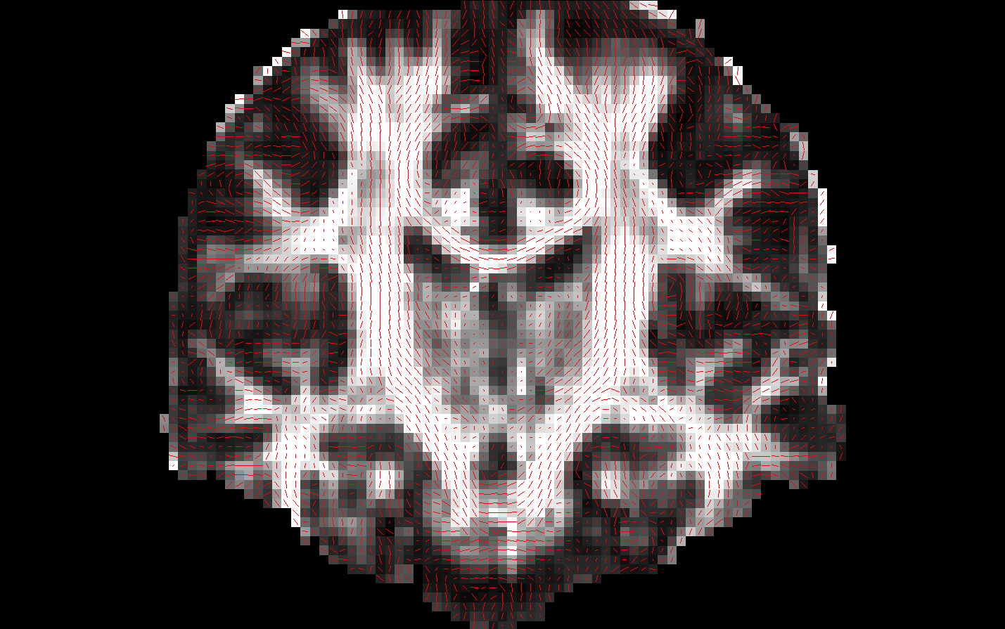
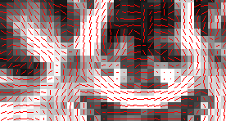
How to represent diffusion
At every voxel we want to know:
Is this in white matter?
If yes, what pathway(s) is it part of?
What is the orientation of diffusion?
What is the magnitude of diffusion?
A standard T1-weighted image cannot capture all this!

Slide 23
Simplest model: Tensor
A tensor is a 3x3 symmetric, positive-definite matrix:
Eigenvectors → diffusion direction
Eigenvalues → diffusion magnitude
d₁₁ d₁₂ d₁₃
d₁₂ d₂₂ d₂₃
d₁₃ d₂₃ d₃₃
D =
Isotropic diffusion:
λ₁ ≈ λ₂ ≈ λ₃
Anisotropic diffusion:
λ₁ >> λ₂ ≈ λ₃
λ₁ e₁
λ₁ e₁
λ₂ e₂
λ₂ e₂
λ₃ e₃
λ₃ e₃
Tensor → Ellipsoid = Likelihood of water molecule displacements at that voxel
Notes:
Linear project based on an orientation distribution function

Slide 24
The many models of diffusion
Variable number of fiber populations: Probability distribution of fiber populations at different diffusion orientations and magnitude (FOD, diffusion spectrum)
Orientation distribution function (ODF): Probability distribution of spin diffusion (orientation only)
Fixed number of fiber populations: Diffusion orientation and magnitude for N compartments (mixture of tensors, ball-and-stick, etc.)
Tensor: Single diffusion orientation and magnitude
Notes:
Many ODF probability density functions rely on linear radial projection, which neglects the change in the volume element along each direction
We estimate that 2/3 of voxels have more than one fiber population!

Slide 25
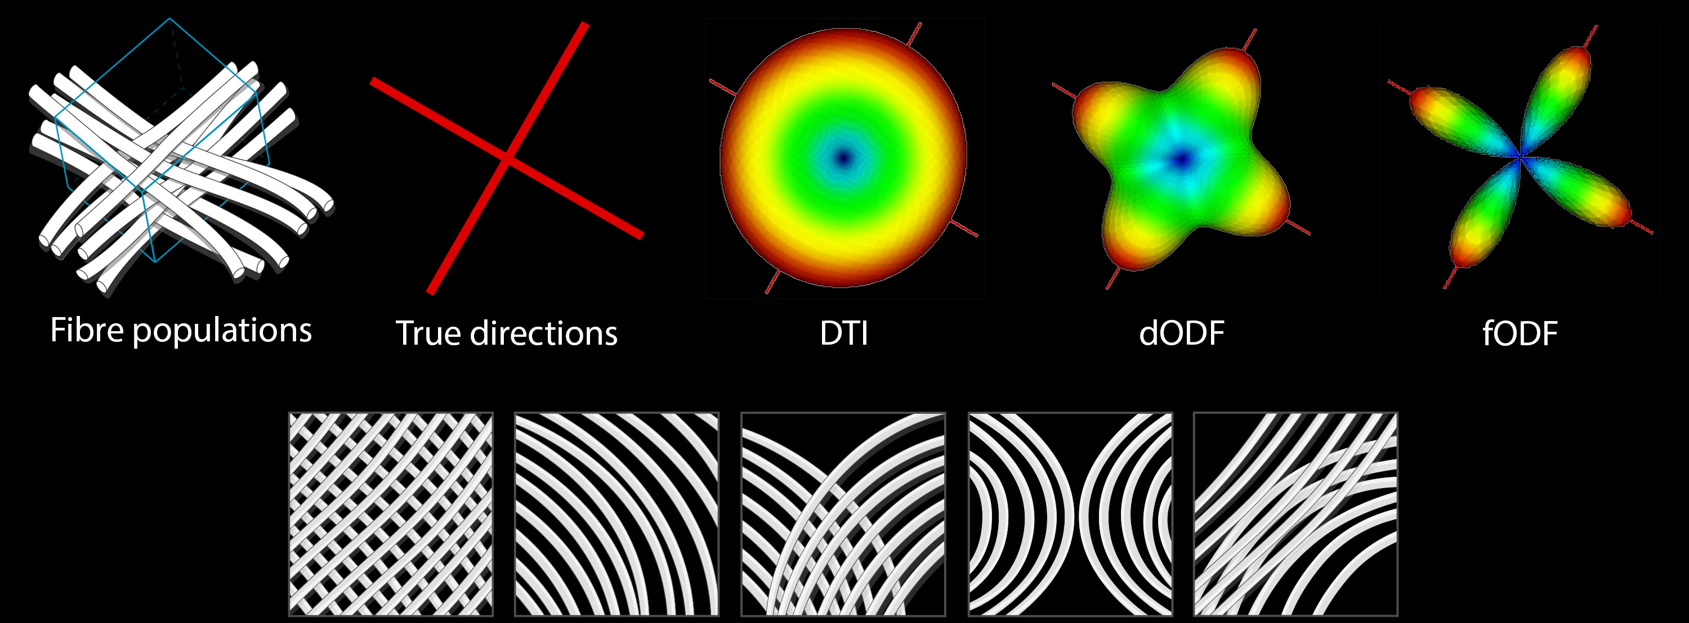
Notes:
the tensor model is insensitive to the complex fiber architectures found in the vast majority of voxels in the human brain.
The inability to resolve intra-voxel fiber orientations may have important implications for the utility of standard DTI-based tract reconstruction methods.
Intra-voxel fiber orientations can now be identified using novel, tensor-free approaches.
The FOD can be then obtained by the inverse operation, i.e. the spherical deconvolution of the diffusion weighted signal by the response function.
Deconvolution: a process of resolving something into its constituent elements or removing complication in order to clarify it.
spherical harmonics are special functions defined on the surface of a sphere.

Slide 27
NDMG Reconstruction
Multiple options available (dODF or fODF):
dODF : Constant Solid Angle (CSA)
fODF : Constrained Spherical Deconvolution (CSD)
Notes:
One of the simplest, yet most robust ODF estimates.
Dimensionless and intrinsically normalized since the integrals of the first and second terms over the sphere are, respectively, 1 and 0.
Works for single and multi-shell data.
Estimate the response function of a single fiber then we could deconvolve the measured signal and obtain the underlying fiber distribution.
Superior to CSA, but computationally more expensive.
Currently only implemented for single-shell data.

Slide 28
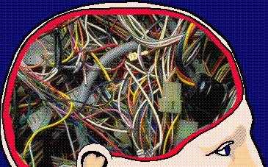
Tractography

Slide 29
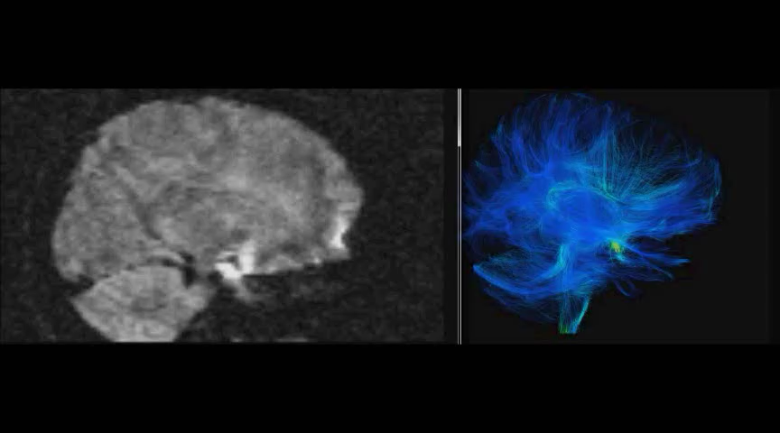
Single Subject Diffusion Weighted MRI
Single Subject White Matter Reconstruction

Slide 30
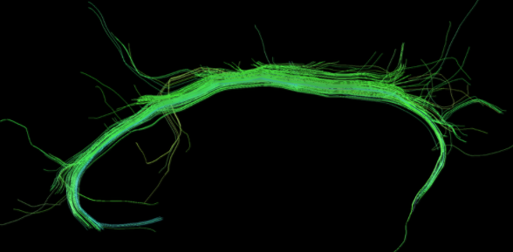
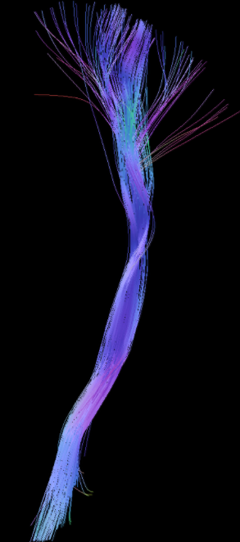
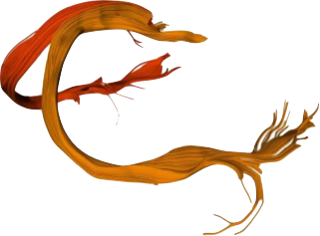
Connectomics is a more recent type of tractography application
Neurosurgical planning
(e.g. tumor removal)
Exploring Individual differences in microstructure of known fascicles/ bundles of white-matter

Slide 31
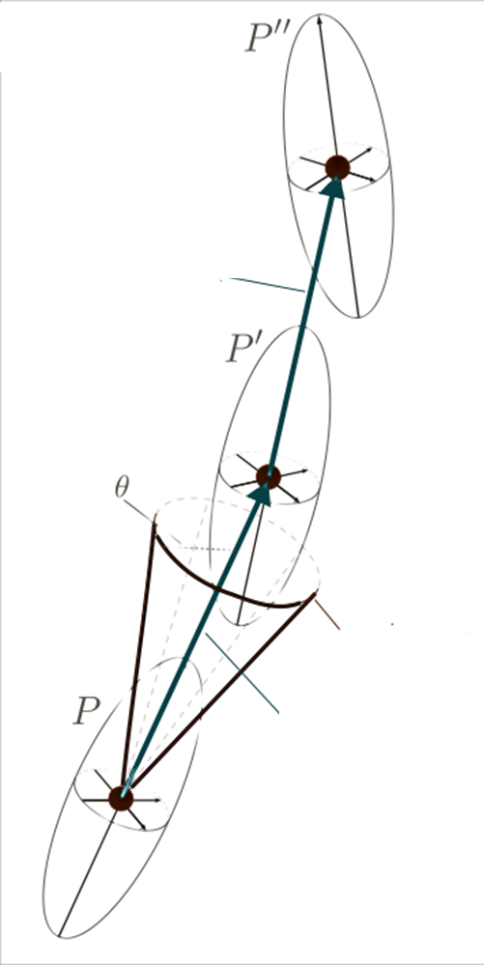
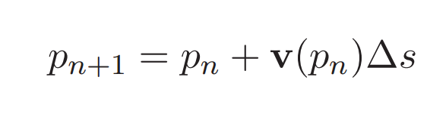
Tracking
For each seed position (initial position)
Follow the path along sequential voxels based on the underlying directional estimate.
Stop if:
The position p_{n} is outside of the mask
The angle between the vector v_{n} and v_{n-1} is greater than the fixed maximum (e.g. opening angle θ=60º)
Restart from the seed in the opposite initial direction
Principal Direction
Maximum Angle
P₀
Δs

Slide 32
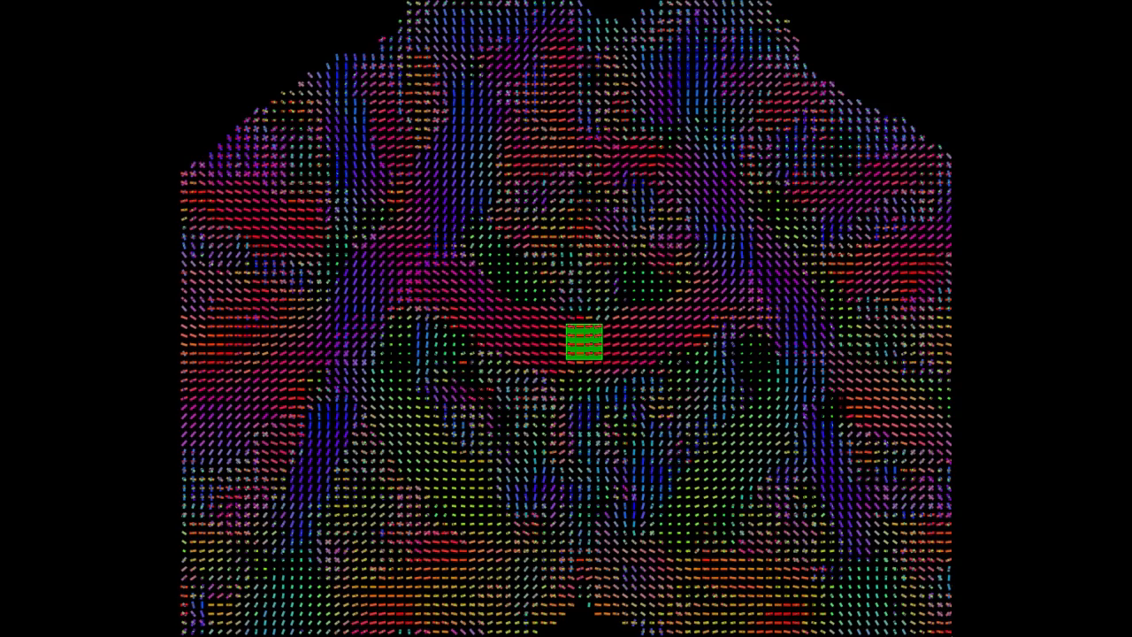
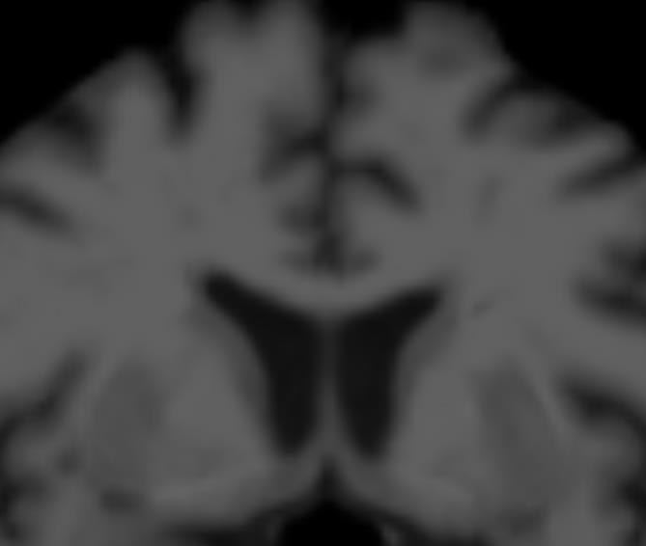
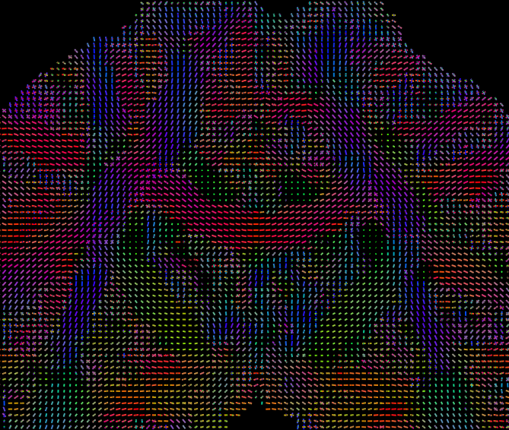
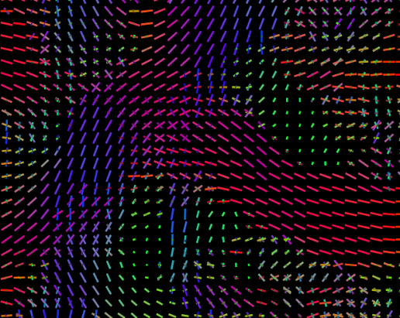
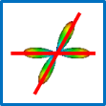
Fiber ODF Tractography

Slide 33
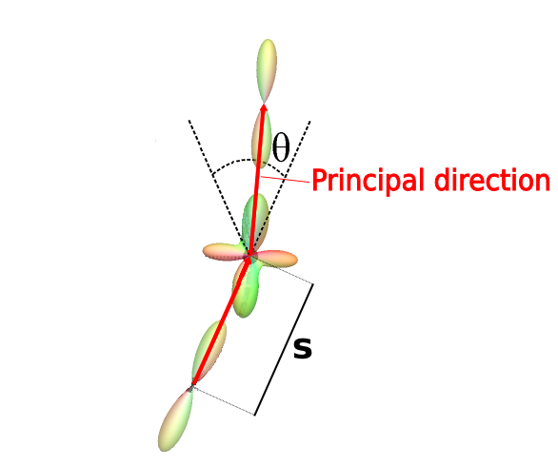
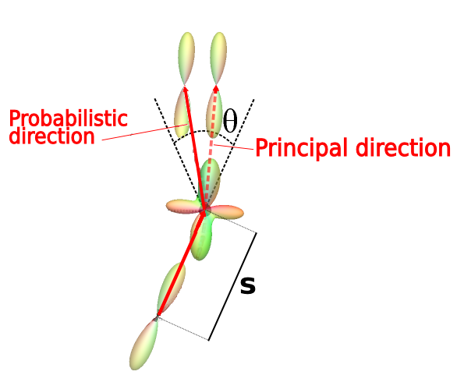
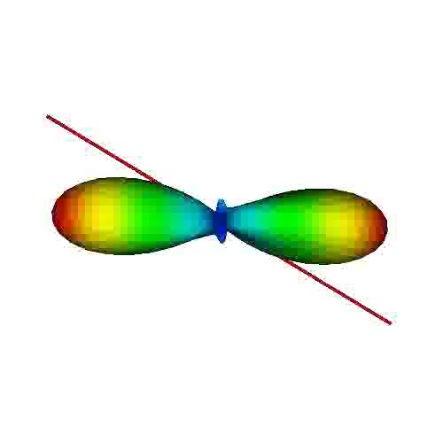
Deterministic vs. Probabilistic Tractography
Deterministic:
Follow the peak direction of the fiber ODF in the (CSA / CSD case)
If multiple peaks are available in the distribution, follow the closest to the incoming direction
Probabilistic:
Sample a direction from the model at each voxel to probabilistically select a direction to follow
Peak / Maximum
ΔS
ΔS : step size
θ : opening angle
Peak / Maximum
ΔS
ΔS : step size
θ : opening angle

Slide 34
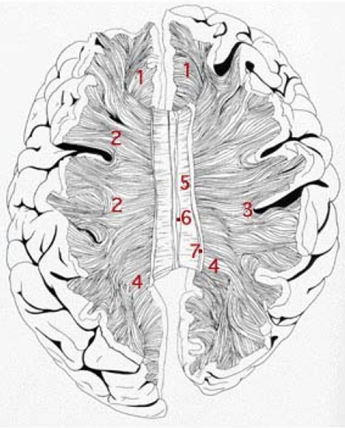
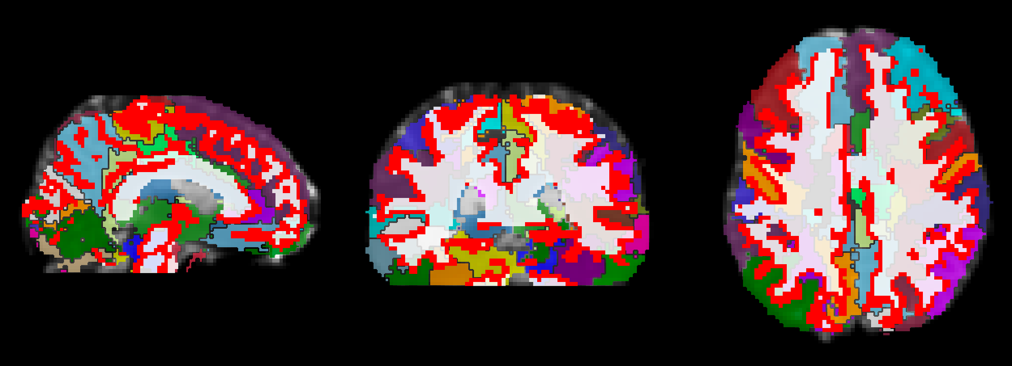
NDMG Tractography
Probabilistic, deterministic, and particle tracking methods available.
Denser seeding (configurable with --seed flag) yields more streamlines.
500,000 -1 million streamlines recommended (need --seed 20/25) (Roine et al. 2019)
Reproducibility increases with streamlines, but it’s compute hungry.
Seeding occurs in:
(1) GM-WM interface
(2) Corpus Callosum
Notes:
as the absolute lower limit for excellent reproducibility
Particle filtering is probabilistic tractography that offers a way to approximate a probability distribution over all paths originated from a specified voxel, given the diffusion information.
Goal: have a tractography that stops in grey matter and avoids CSF.
Here’s how it works:
Particle Filtering Tractography (PFT) [Girard2014] uses tissue partial volume estimation (PVE) to reconstruct trajectories connecting the gray matter, and not incorrectly stopping in the white matter or in the corticospinal fluid. It relies on a tissue classifier that identifies the tissue where the streamline stopped. If the streamline correctly stopped in the gray matter, the trajectory is kept. If the streamline incorrecly stopped in the white matter or in the corticospinal fluid, PFT uses anatomical information to find an alternative streamline segment to extend the trajectory. When this segment is found, the tractography continues until the streamline correctly stops in the gray matter.

Slide 35
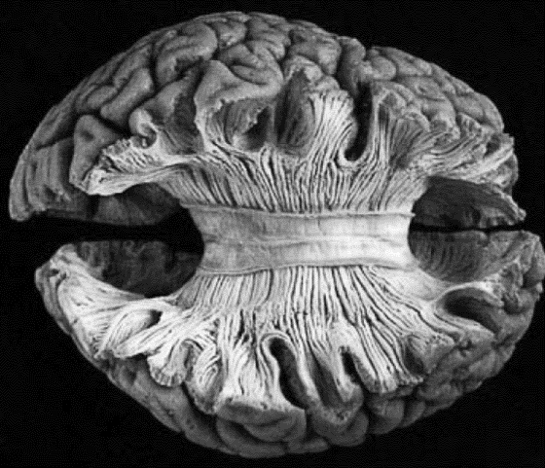
Challenge: Recovering contralateral connections
Especially populous (150-200 million) commissural (interhemispheric) fibers need to be tracked somehow!
Sufficiently large step-size in tractography can help. NDMG uses 0.2 by default.
Denser seeding from Corpus Callosum can also help, so in NDMG we do this.
Notes:
Maier-Hein study created a simulated human brain data set with ground truth tracts
Ex vivo imaging and tracing^{17,18,19,20,21,22,23} or physically^{24,25,26,27,28,29,30} and numerically simulated phantoms^{31,32,33,34} allow validation to some extent, and in specific circumstances such as basic fiber configurations. The nervous system, however, is complex and precise ground truth information on the trajectories of pathways and their origins, as well as terminations in the human brain is lacking. This makes it hard to obtain quantitative and comprehensive reliability estimations of tractography and to determine which discoveries are reliable when regarding brain connectivity in health and disease.

Slide 36
Increasing biological validity
Step 1: Use underlying tissue information (from the T1w) in the tracking:
Avoid ventricular CSF
Only track within tissue that has >0.05 probability of being WM.
Step 2: Use streamline filtering (Malcolm et al., 2010)
By minimum fiber length (>10-60mm)
May reduce false positives by 80-90%!
Notes:
Maier-Hein study created a simulated human brain data set with ground truth tracts
Ex vivo imaging and tracing^{17,18,19,20,21,22,23} or physically^{24,25,26,27,28,29,30} and numerically simulated phantoms^{31,32,33,34} allow validation to some extent, and in specific circumstances such as basic fiber configurations. The nervous system, however, is complex and precise ground truth information on the trajectories of pathways and their origins, as well as terminations in the human brain is lacking. This makes it hard to obtain quantitative and comprehensive reliability estimations of tractography and to determine which discoveries are reliable when regarding brain connectivity in health and disease.
IFOF → longest fiber in the brain

Slide 37
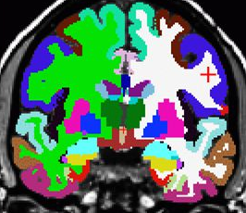
Graph Generation
Nodes = Grey matter regions of interest (from an atlas) containing streamline endpoints
Edges = Properties of white matter revealed by tractography streamlines (i.e. their number and integrity)

Slide 38


What counts as nodes? (Surfaces vs. Volumes)
Streamlines points intersecting with surfaces
Streamline points intersecting with volumes

Slide 39
What counts as an edge?
Must volumetrically pass through the voxels of an atlas label (i.e. node).
What degree of overlap constitutes a “connection”?
Limitation of volumetric nodes (vs. more compute-demanding surface-style nodes)
Notes:
Maier-Hein study created a simulated human brain data set with ground truth tracts
Ex vivo imaging and tracing^{17,18,19,20,21,22,23} or physically^{24,25,26,27,28,29,30} and numerically simulated phantoms^{31,32,33,34} allow validation to some extent, and in specific circumstances such as basic fiber configurations. The nervous system, however, is complex and precise ground truth information on the trajectories of pathways and their origins, as well as terminations in the human brain is lacking. This makes it hard to obtain quantitative and comprehensive reliability estimations of tractography and to determine which discoveries are reliable when regarding brain connectivity in health and disease.
One solution: consider a ‘Euclidian neighborhood’ of a volume-based parcel (e.g. by dilating the parcel) may perform even better at less cost.

Slide 40
Discriminability
Notes:
Maier-Hein study created a simulated human brain data set with ground truth tracts
Ex vivo imaging and tracing^{17,18,19,20,21,22,23} or physically^{24,25,26,27,28,29,30} and numerically simulated phantoms^{31,32,33,34} allow validation to some extent, and in specific circumstances such as basic fiber configurations. The nervous system, however, is complex and precise ground truth information on the trajectories of pathways and their origins, as well as terminations in the human brain is lacking. This makes it hard to obtain quantitative and comprehensive reliability estimations of tractography and to determine which discoveries are reliable when regarding brain connectivity in health and disease.
One solution: consider a ‘Euclidian neighborhood’ of a volume-based parcel (e.g. by dilating the parcel) may perform even better at less cost.

Slide 41


Notes:
Maier-Hein study created a simulated human brain data set with ground truth tracts
Ex vivo imaging and tracing^{17,18,19,20,21,22,23} or physically^{24,25,26,27,28,29,30} and numerically simulated phantoms^{31,32,33,34} allow validation to some extent, and in specific circumstances such as basic fiber configurations. The nervous system, however, is complex and precise ground truth information on the trajectories of pathways and their origins, as well as terminations in the human brain is lacking. This makes it hard to obtain quantitative and comprehensive reliability estimations of tractography and to determine which discoveries are reliable when regarding brain connectivity in health and disease.
One solution: consider a ‘Euclidian neighborhood’ of a volume-based parcel (e.g. by dilating the parcel) may perform even better at less cost.

Slide 42
Ways to run NDMG:
Locally on your laptop/desktop
In a Docker or singularity container
On Amazon Web Services (AWS)
On HPC (e.g. SLURM scheduler)
In Gigantum

Slide 43
dpisner@utexas.edu
https://github.com/dPys

